Slide 1
Computer Graphics labs
Lab 3 - Transformation
-…
-Painter’s Algorithm
-Depth Buffer
-Z fighting
-Back Face Culling

Slide 2
Quick Review

Slide 3
(-1, 1, -1)
( 1, 1, -1)
(-1, 1, 1)
( 1, 1, 1)
( 1, -1, -1)
(-1, -1, 1)
( 1, -1, 1)

Slide 4
What if we want a bigger cube?
( 2, 2, -2)
( 1, 1, -1)
SCALE ✕2
(-1, -1, 1)
(-2, -2, 2)
(x, y, z)
SCALE ✕ S = (S_{x}, S_{y}, S_{z})
(s_{x}x, s_{y}y, s_{z}z)

Slide 5
What if we want to rotate?
( 0, √2, -2)
( 1, 1, -1)
ROTATE AROUND Z BY 45°
(-1, -1, 1)
( 0, -√2, 2)
(x, y, z)
ROTATE AROUND Z BY θ°
(xcosθ - ysinθ, xsinθ + ycosθ, z)

Slide 6
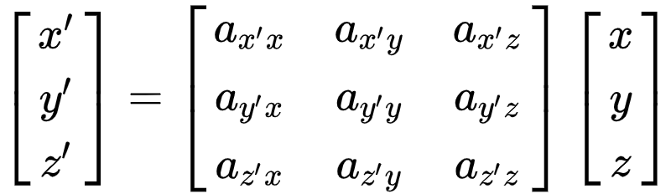
Lets generalize
A matrix can represent any linear transformation

Slide 7
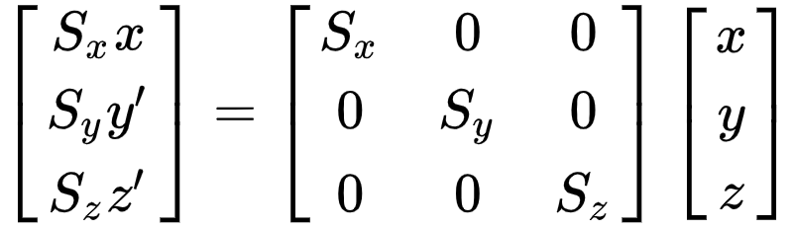
Scaling

Slide 8
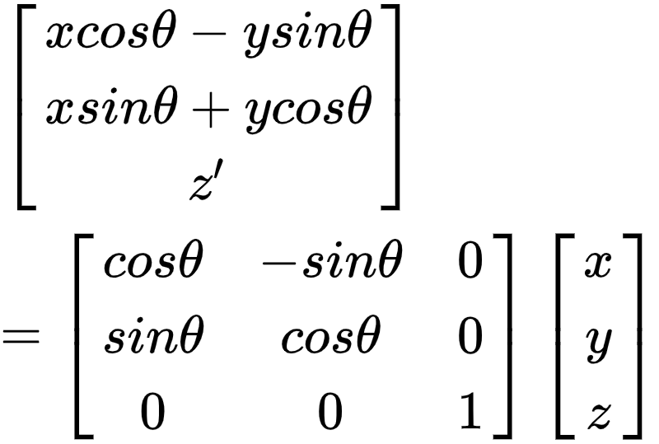
Rotate around Z

Slide 9
But what about translation?
( 1, 1, -1)
( 2, 2, 0)
TRANSLATE BY (1, 1,-1)
(-1, -1, 1)
(0, 0, 2)
(x, y, z)
TRANSLATE BY (Δx, Δy, Δz)
(x+Δ_{x}, y+Δ_{y}, z+Δ_{z})
Result is not a linear combination of (x, y, z)

Slide 10
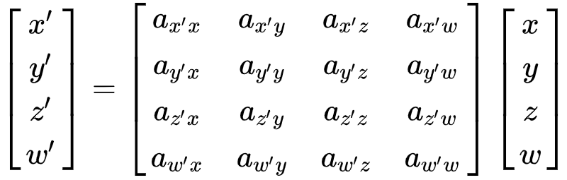
Welcome to the 4th Dimension
We call “w” the homogenous component

Slide 11
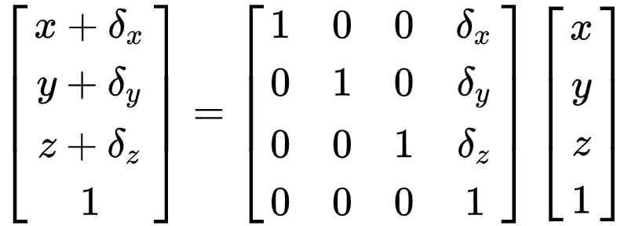
Translation
For points, we set “w” to 1.

Slide 12
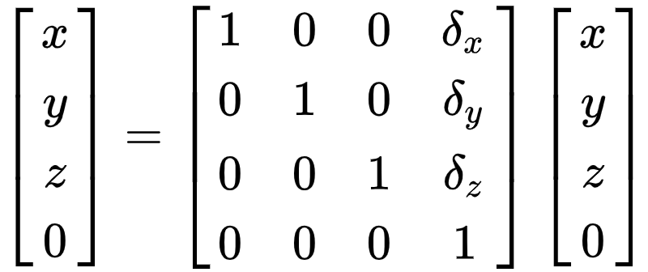
Translation
For vPectors, we set “w” to 0.

Slide 13
A point represents a location in space.
w=1
A vector represents direction and magnitude.
w=0

Slide 14
Vector + Vector = Vector
Vector - Vector = Vector
Point + Vector = Point
Point - Vector = Point
Vector - Point = INVALID
Point - Point = Vector
Point + Point = INVALID

Slide 15
Point + Point
= Point
2

Slide 16
What if we want to do multiple transformations?
v₁ = M₁ v₀
v₂ = M₂ v₁
v₃ = M₃ v₂
v₄ = M₄ v₃
v₅ = M₅ v₄
...
v_{n} = M_{n} v_{n-1}

Slide 17
Matrix Composition
v_{n} = M_{n} M_{n-1} … M₃ M₂ M₁ v₀
v_{n} = (M_{n} M_{n-1} … M₃ M₂ M₁) v₀
v_{n} = M v₀
Where M = M_{n} M_{n-1} … M₃ M₂ M₁

Slide 18
SCALE BY (1, 2, 1)
ROTATE AROUND Z BY 45°
S
R
v’ = RSv

Slide 19
ROTATE AROUND Z BY 45°
SCALE BY (1, 2, 1)
R
S
v’ = SRv

Slide 20
Order Matters
RS ≠ SR

Slide 21
Order Matters
v_{n} = M_{n} M_{n-1} … M₃ M₂ M₁ v₀
Applied Last
Applied First
M = M_{n} M_{n-1} … M₃ M₂ M₁
Order of Application

Slide 22
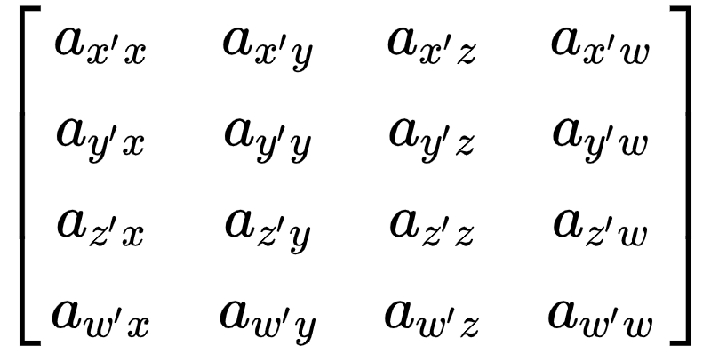
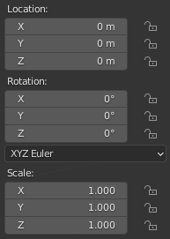
How to represent Transformations?
4x4 Matrix
Translation Rotation Scaling (TRS)
VS
PROS:
Can represent any affine transformation.
Easy to apply.
PROS:
Human Friendly
Covers most common use cases.
More compact (9 vs 16 floats).
CONS:
Not human friendly.
Has redundant elements for most use-cases.
CONS:
Can’t represent some transformations (e.g. Shearing).
Has to be converted to a 4x4 Matrix in most cases.

Slide 23
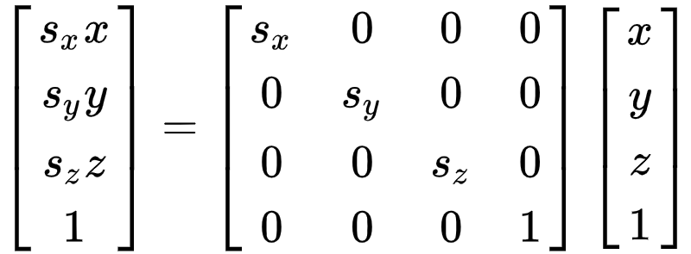
Translation can be stored in a 3D vector.
Scaling can also be stored in a 3D vector.

Slide 24
glm::mat4 matrix = glm::translate(glm::mat4(1.0f), translation);
glm::mat4 matrix = glm::scale(glm::mat4(1.0f), scale);

Slide 25
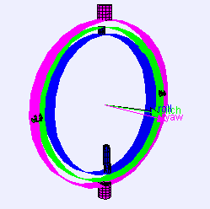
WHAT ABOUT ROTATION?

Slide 26
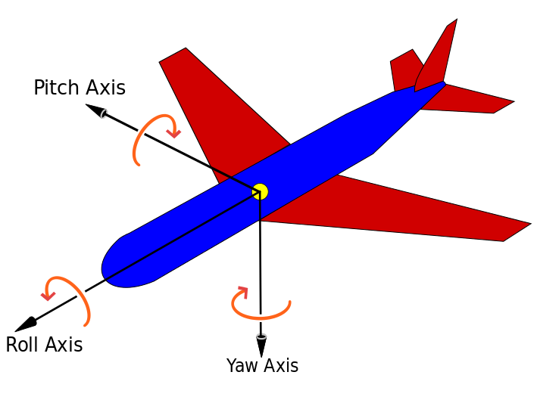
Euler Angles
We can represent any rotations using 3 angles.
Yaw-Pitch-Roll are the most popular euler angles which consists of:
Yaw: rotation around Y axis.
Pitch: rotation around X axis.
Roll: rotation around Z axis.
The order of application is: Roll, Pitch, Yaw.

Slide 27
#include <glm/gtx/euler_angles.hpp>
glm::mat4 matrix = glm::yawPitchRoll(rotation.y, rotation.x, rotation.z);

Slide 28
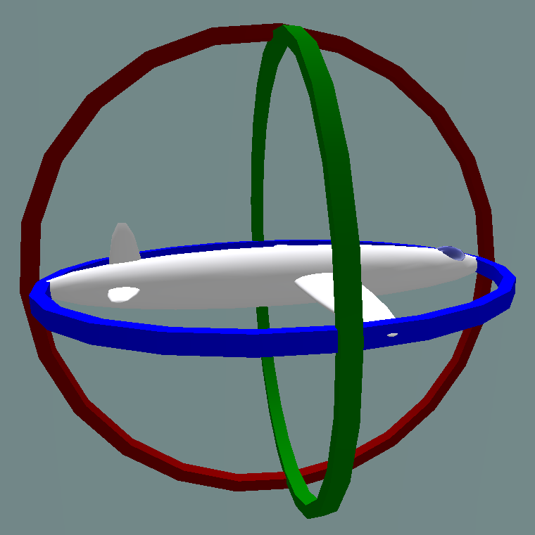
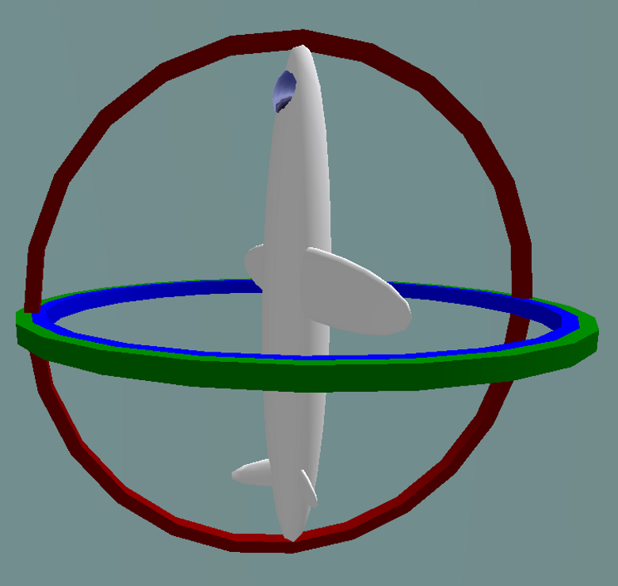
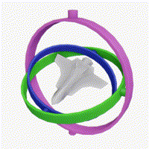
Euler Angles
Pitch
90°
PROS
Human friendly.
Can represent any rotation.
CONS
Can suffer from Gimbal Lock.
Not unique (multiple euler angles can lead to the same rotation).
Not friendly with some animations (Interpolation).

Slide 29
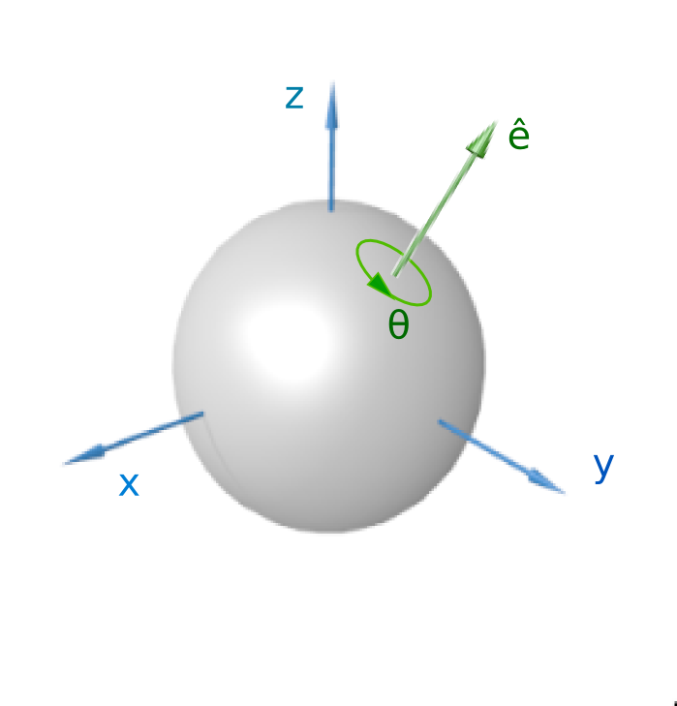
Axis-Angle Representation
Based on “Euler's rotation theorem”, any rotation can be represented as an Axis and an Angle.
It contains:
A rotation axis (3D Vector). (e)
A rotation angle. (Theta)

Slide 30
#include <glm/gtx/matrix_interpolation.hpp>
glm::mat4 matrix = glm::axisAngleMatrix(axis, angle);

Slide 31
Axis-Angle Representation
PROS
No Gimbal Lock.
Can represent any rotation.
CONS
Still not friendly with some animations (Interpolation).

Slide 32
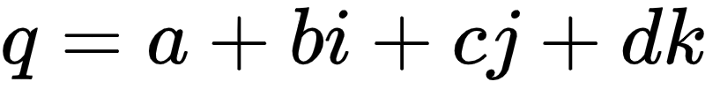
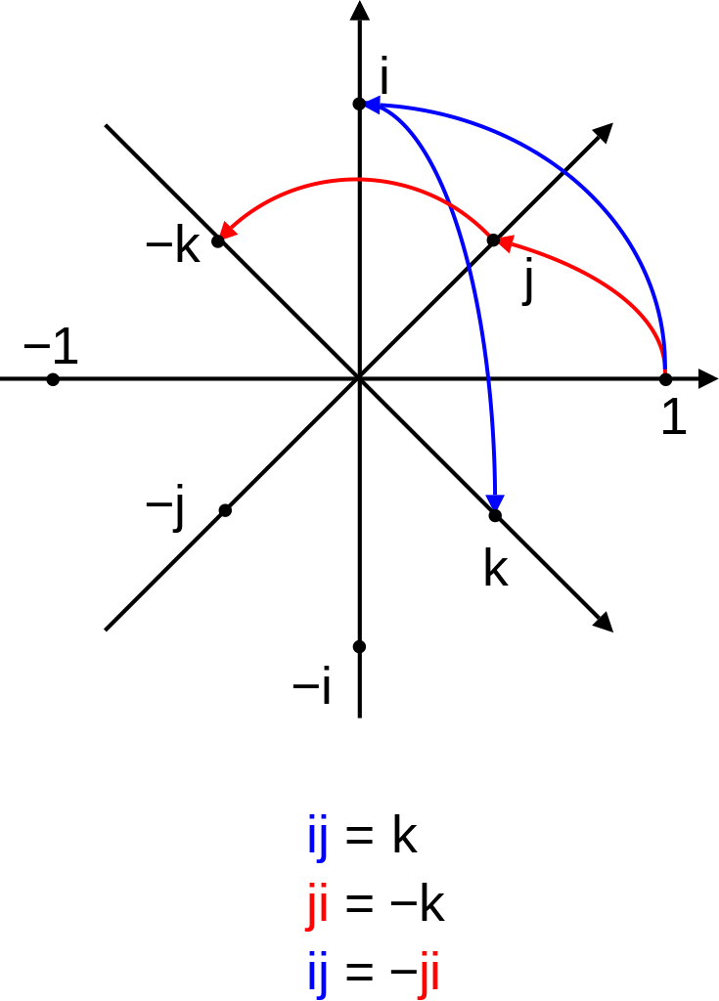
Quaternion
Just complex numbers but in 3D.
It is usually represented as a 4D vector where “w” is the real part.
It has some nice properties that makes them popular for representing rotation.
For example, two rotations can be composed via quaternion multiplication.

Slide 33
Axis-Angle to Quaternion

Slide 34
#include <glm/gtc/quaternion.hpp>
glm::quat quaternion = glm::N(angle, axis);
glm::mat4 matrix = glm::mat4_cast(quaternion);
glm::quat quaternion = glm::quat(glm::vec3(pitch, yaw, roll));
glm::mat4 matrix = glm::mat4_cast(quaternion);

Slide 35
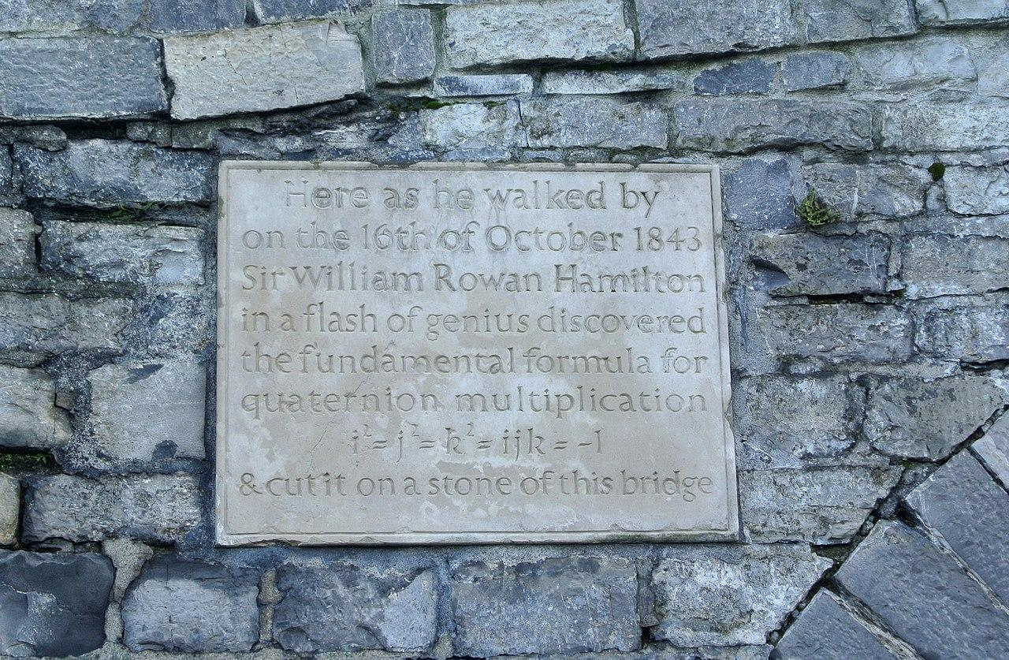
Quaternion
PROS
No Gimbal Lock.
Can represent any rotation.
Powerful mathematical properties.
Easy interpolation (Good for Animation).
CONS
Not Human Friendly At All.

Slide 36
Most common order of TRS
v’ = Translation * Rotation * Scaling * v

Slide 37
What if we want Shearing for example?
v’ = TRS_{n} * ... * TRS₂ * TRS₁ * v
We can keep nesting them tell we get what we want.
More on that when we get to Scene Graphs.

Slide 38
Let’s talk about Spaces

Slide 39
(-1, 1, -1)
( 1, 1, -1)
Data in Vertex Buffer
Sent to Position Attribute
-1, -1, -1
(-1, 1, 1)
( 1, 1, 1)
1, -1, -1
-1, 1, -1
1, 1, -1
...
...
( 1, -1, -1)
...
(-1, -1, 1)
( 1, -1, 1)

Slide 40
vec4 world_position = model_matrix * vec4(position, 1.0);
Assume we transform our position using a matrix called “model_matrix”

Slide 41
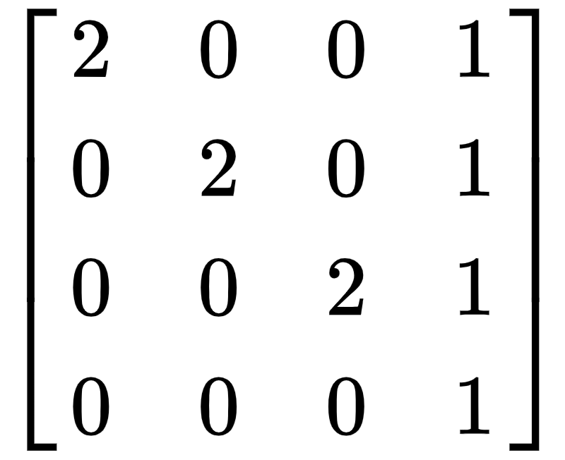
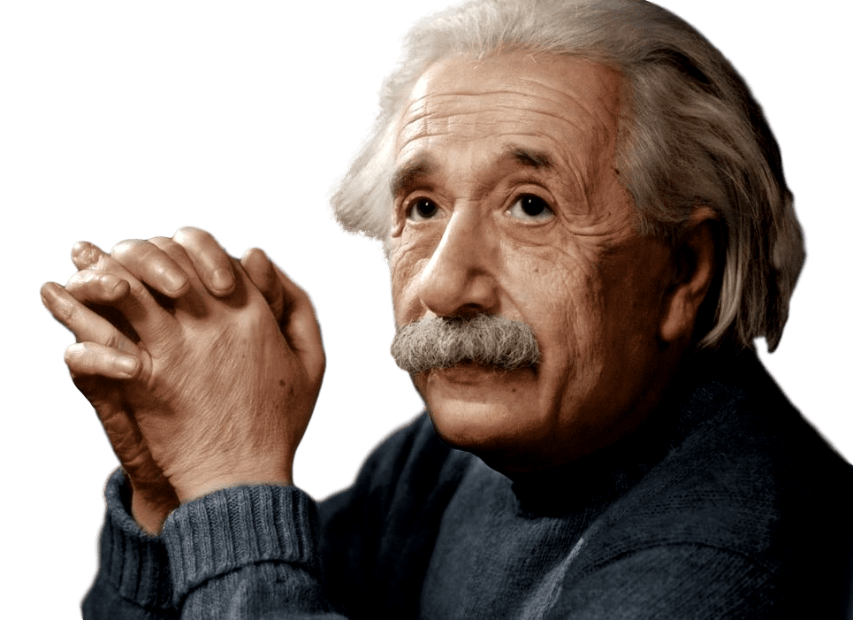
Both of these are the same point but in different spaces.
model_matrix
A
A
( 1, 1, -1)
( 3, 3, -1)
(-1, -1, 1)
(-1, -1, 3)
position
world_position.xyz

Slide 42
Same Mesh
(Vertex Data)
(-1, 7, -1)
A
A
A
( 1, 1, -1)
( 3, 3, -1)
(-5, 3, 3)
A
( 7, -1, -1)
(-1, -1, 1)
(-1, -1, 3)
3 Draw Calls
With Different Matrices
( 3, -5, 3)

Slide 43
(-1, 7, -1)
( 1, 1, -1)
( 3, 3, -1)
(-5, 3, 3)
( 7, -1, -1)
(-1, -1, 1)
(-1, -1, 3)
Model Matrices
( 3, -5, 3)
Local Space
World Space

Slide 44
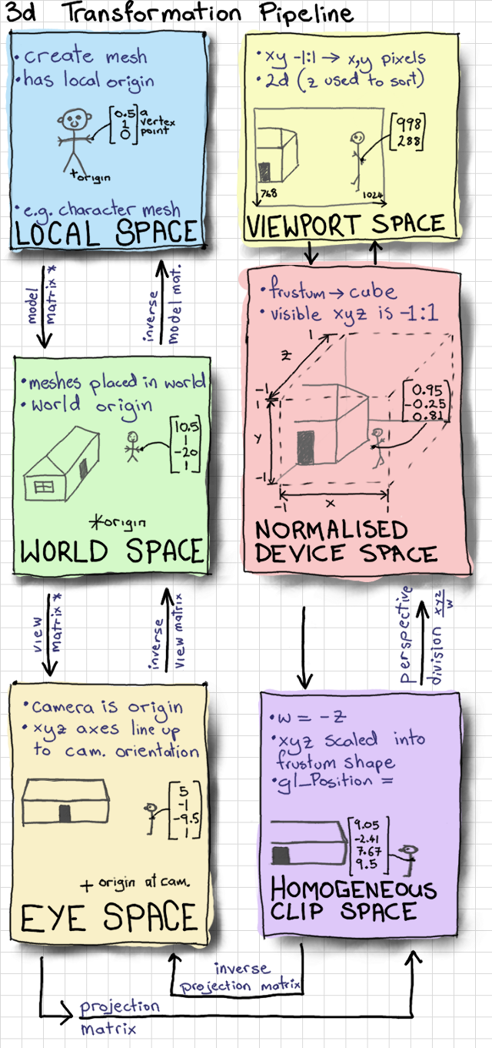
Notes:
Source: https://antongerdelan.net/opengl/raycasting.html

Slide 45
Let’s talk about Cameras

Slide 46

Cameras
SCREEN

Slide 47
Cameras
SCREEN

Slide 48
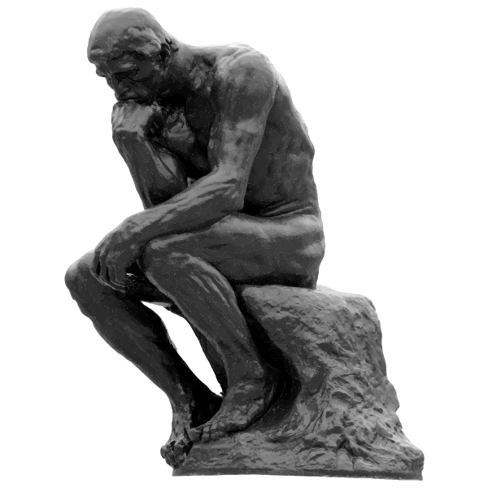
Did the camera move right or did the box move left?
YES

Slide 49
SCREEN
v’ = M⁻¹_{camera} M_{model} v

Slide 50
v’ = M_{view} M_{model} v
Where M_{view} = M⁻¹_{camera}
The View Matrix is responsible for making everything in the scene relative to the camera.
After the view transformation, the camera is at the origin, looking in the direction (0, 0, -1) and it’s up direction is pointing (0, 1, 0).

Slide 51
y
y
x
x
z
z
World Space to Camera Space
(View Matrix)

Slide 52
Notes:
Source: https://antongerdelan.net/opengl/raycasting.html

Slide 53
The view matrix only translates and rotates.
Camera Up Direction
Camera LookAt Direction
Camera Position
(x, y, z)

Slide 54
#include <glm/gtc/matrix_transform.hpp>
glm::mat4 view_matrix = glm::lookAt(eye, center, up);
Where the camera is.
Where the camera’s y-axis is pointing to.
Where the camera is looking at.

Slide 55

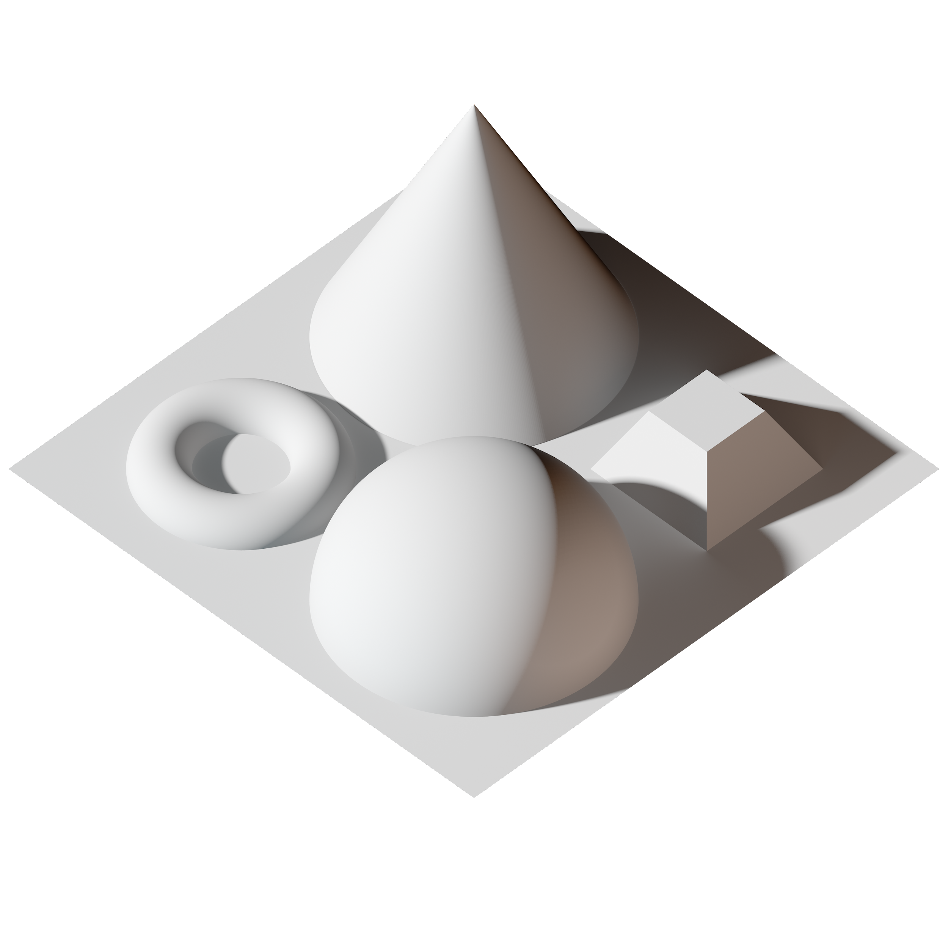
Camera Up

Slide 56
Camera Up

Slide 57
Camera Up

Slide 58
Camera Up

Slide 59
But our objects are still 3D but our screen is 2D.

Slide 60

Notes:
Credits: Tom & Jerry - MGM

Slide 61
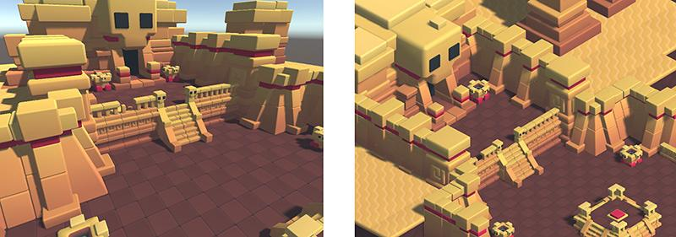
The most popular projections for Cameras
Perspective
Orthographic
Notes:
Source: https://docs.unity3d.com/es/2018.3/Manual/CamerasOverview.html

Slide 62
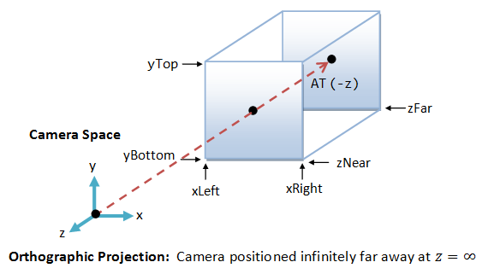
Orthographic Projection
Notes:
Source: https://www3.ntu.edu.sg/home/ehchua/programming/opengl/CG_BasicsTheory.html

Slide 63
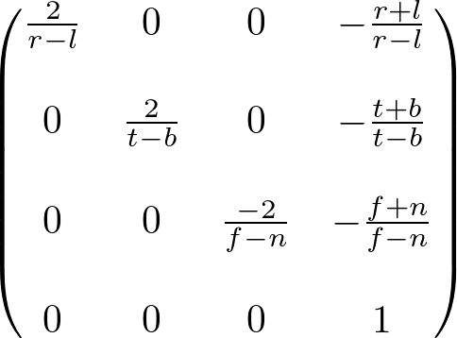
Notes:
Source: http://www.songho.ca/opengl/gl_projectionmatrix.html

Slide 64
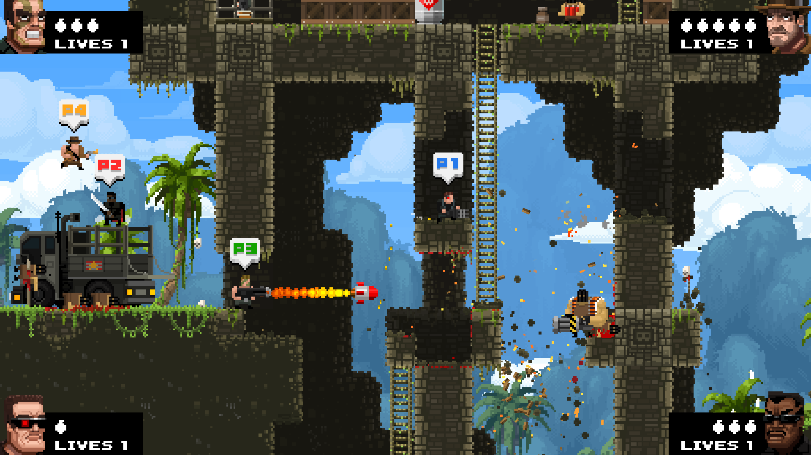
12m
Top=5m, Bottom=9m,
Left=13m, Right=21m
25m
The Effect of Top/Bottom & Left/Right
Top=6.5m, Bottom=8.5m,
Left=8m, Right=12m
Notes:
Source: BROFORCE

Slide 65
#include <glm/gtc/matrix_transform.hpp>
glm::mat4 projection_matrix = glm::ortho(left, right, bottom, top, near, far);
The camera can’t see anything nearer than “near” and farther than “far”

Slide 66
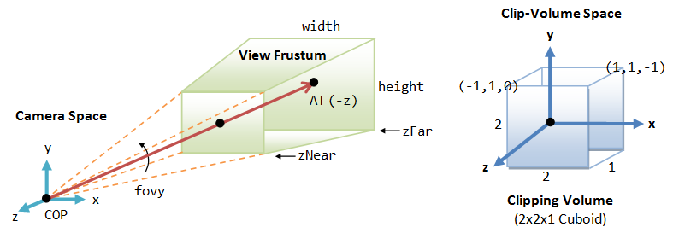
Perspective Projection
Notes:
Source: https://www3.ntu.edu.sg/home/ehchua/programming/opengl/CG_BasicsTheory.html

Slide 67
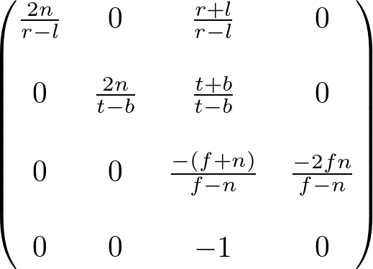
Notes:
Source: http://www.songho.ca/opengl/gl_projectionmatrix.html

Slide 68
#include <glm/gtc/matrix_transform.hpp>
glm::mat4 projection_matrix = glm::perspective(I, aspect_ratio, near, far);
Vertical FOV Angle
Viewport width/height
The camera can’t see anything nearer than “near” and farther than “far”

Slide 69
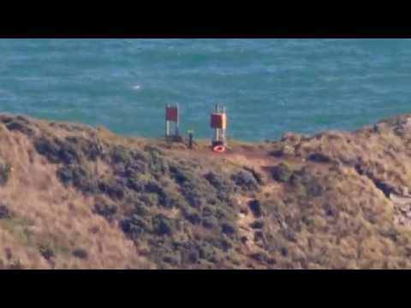
Field of View Angle
It determines how much of the scene will be visible on the screen.
To zoom in, decrease the fov angle.
To zoom out, increase the fov angle.

Slide 70
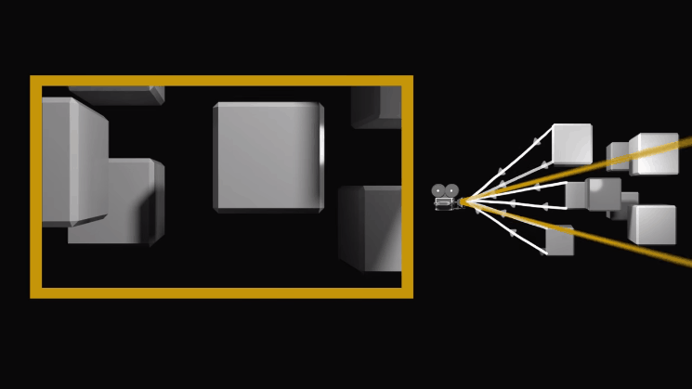
Notes:
Source: https://www.diyphotography.net/definitive-guide-focal-length-perspective-zooming-feet-nonsense/

Slide 71


640 px
1280 px
480 px
720 px
Aspect Ratio = 4:3
Aspect Ratio = 16:9

Slide 72
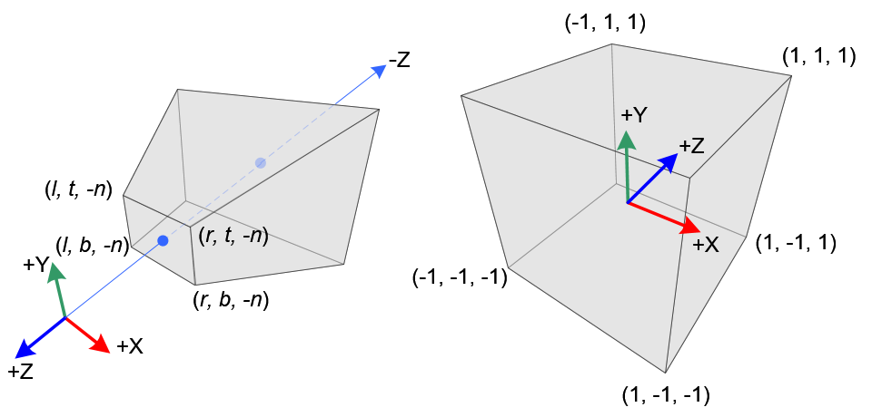
After perspective projection, W = -Z_{view} )Remeber we added -1 @ last row of the Matrix)so after division by W, far objects become smaller.
Notes:
Source: http://www.songho.ca/opengl/gl_projectionmatrix.html

Slide 73
v’ = M_{projection} M_{view} M_{model} v

Slide 74
Notes:
Source: https://antongerdelan.net/opengl/raycasting.html

Slide 75
Homogeneous Clip Space
Since the homogeneous component “w” may not be 1. We can’t omit it yet.
Since clipping is done in this space.

Slide 76
Our job is to get the point from this space
OpenGL will do the rest.
to this space
Notes:
Source: https://antongerdelan.net/opengl/raycasting.html

Slide 77
M_{projection} M_{view} M_{model}
Calculate the whole transformation from local to clip space on the CPU. Then send it as a uniform to the GPU.
gl_Position = transform * vec4(position, 1.0);

Slide 78
But what is OpenGL doing here?

Slide 79
OpenGL takes our point from the homogeneous clip space to the normalized device coordinates.
gl_Position.xyz /= gl_Position.w;

Slide 80
y
z
(-1, 1, 1)
( 1, 1, 1)
(-1, 1, -1)
( 1, 1, -1)
(-1, 1)
y
( 1, 1)
x
( 0, 0)
x
(-1, -1)
( 1, -1)
( 1, -1, 1)
(-1, -1, -1)
( 1, -1, -1)
Normalized Device Coordinates (NDC)

Slide 81
But screens are pixels so we need to measure our points in pixels.
That is the final space.
pixel_location = viewport_size * (point_ndc.xy + 1.0) / 2.0;

Slide 82
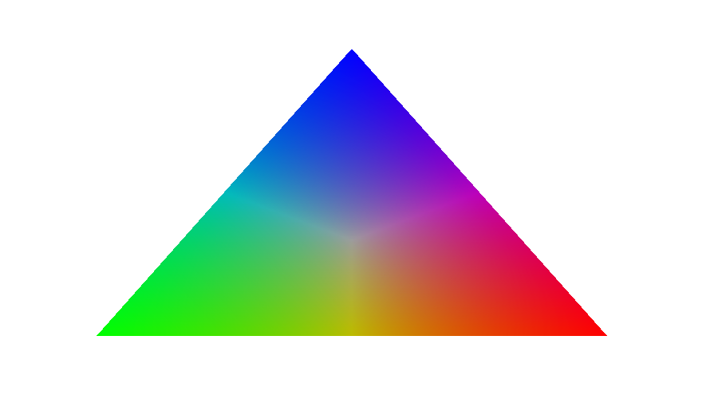
Perspective Correct
Barycentric Interpolation
A
B
Z
u = ZBC / ABC
v = AZC / ABC
w = ABZ / ABC
S = u/A_{w} + v/B_{w} + w/C_{w}
C_{Z} = (uC_{A}/A_{w} + vC_{B}/B_{w} + wC_{C}/C_{w}) / S
C

Slide 83

Why we need perspective correct interpolation?
On screen, the orange bar is halfway between the near and far bars. But on the ground in 3D space (world space), it is actually much closer to the near bar.

Slide 84
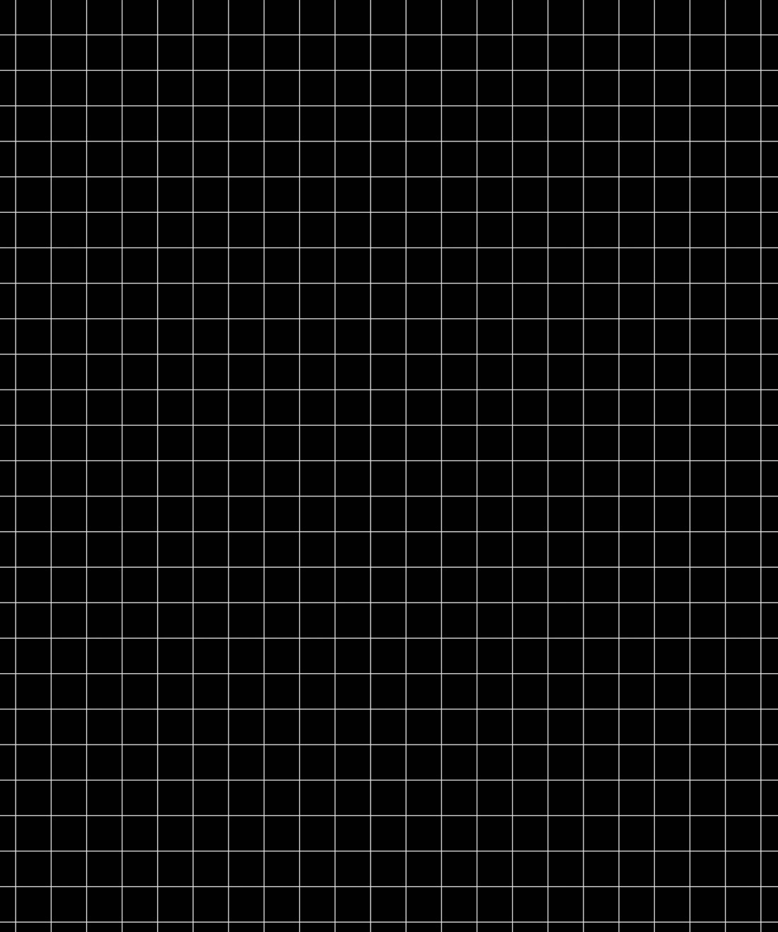
Why we need perspective correct interpolation?
On screen, the orange bar is halfway between the near and far bars. But on the ground in 3D space (world space), it is actually much closer to the near bar.

Slide 85
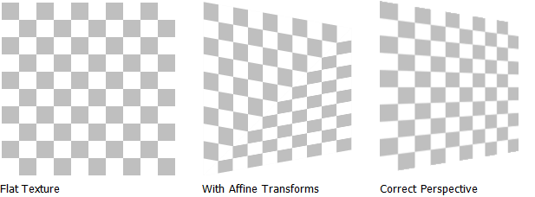
Notes:
Source: https://princeofbugs.wordpress.com/2016/05/10/history-of-texturing/

Slide 86
Now we no longer need W.
But what about Z?

Slide 87

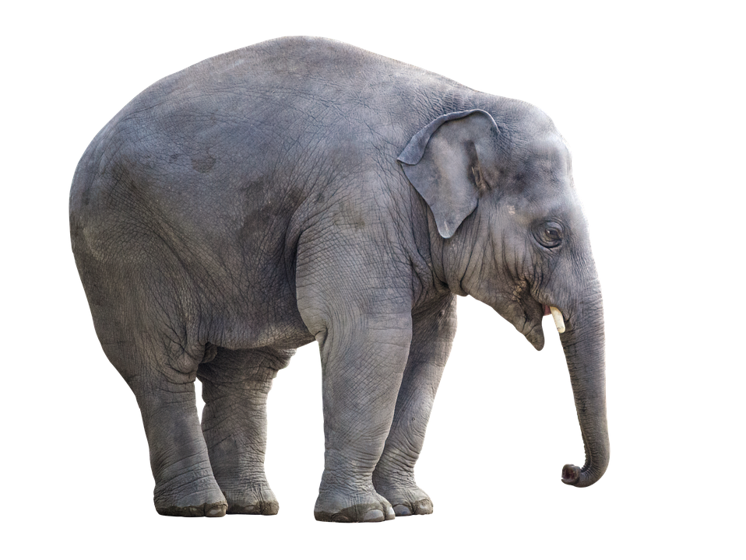
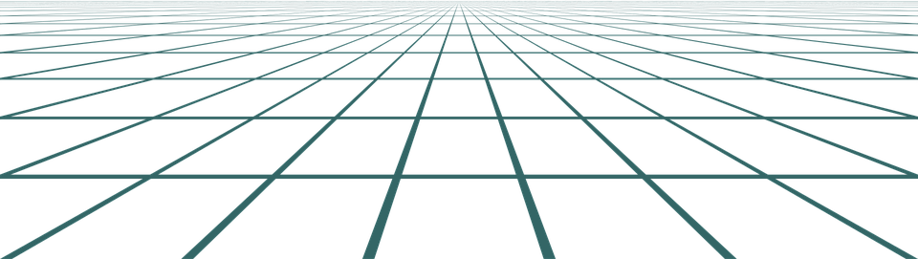

Slide 88
Instructions:
Draw Ground
Draw Tree
Draw Elephant
Draw Sun

Slide 89
Instructions (Sorted):
Draw Sun
Draw Ground
Draw Elephant
Draw Tree
Painter’s Algorithm:
Sort by depth from back to front

Slide 90
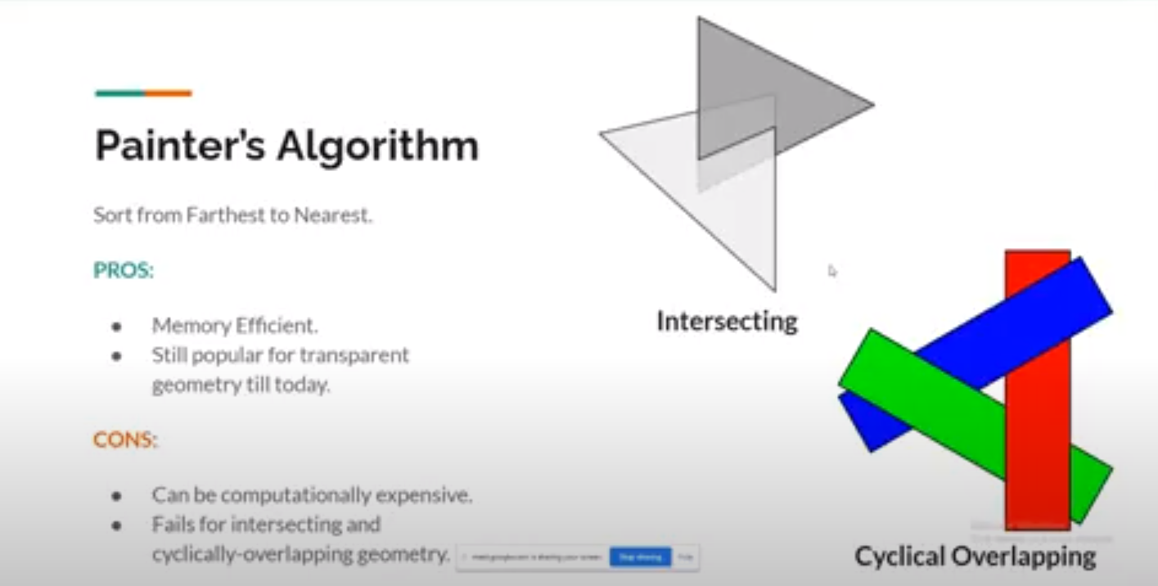
But Painter’s Algorithm doesn’t work with intersecting & cyclically overlapping geometry

Slide 91
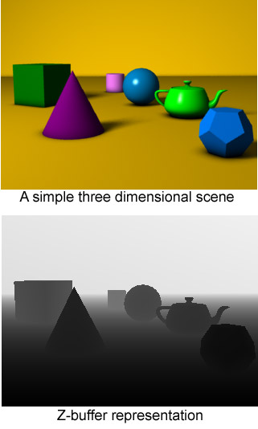
Depth Buffer (Z-Buffer)
Store a depth value for each pixel (sample in case of MSAA).

Slide 92
glEnable(GL_DEPTH_TEST);
glDepthFunc(GL_LEQUAL);

Slide 93
Instructions:
Draw Ground
Draw Tree
Draw Elephant
Draw Sun
1.0
1.0
1.0
1.0
1.0
1.0
1.0
1.0
1.0
1.0
1.0
1.0
1.0
1.0
1.0
1.0
1.0
1.0
1.0
1.0
1.0
1.0
1.0
1.0
1.0
1.0
1.0
1.0
1.0
1.0
1.0
1.0
1.0
1.0
1.0
1.0
1.0
1.0
1.0
1.0
1.0
1.0
1.0
1.0
1.0
1.0
1.0
1.0
1.0
1.0
1.0
1.0
1.0
1.0
1.0
1.0
1.0
1.0
1.0
1.0
1.0
1.0
1.0
1.0
1.0
1.0
1.0
1.0
1.0
1.0
1.0
1.0
1.0
1.0
1.0
1.0
1.0
1.0
1.0
1.0
1.0
1.0
1.0
1.0
Depth Testing
1.0
1.0
1.0
1.0
1.0
1.0
1.0
1.0
1.0
1.0
1.0
1.0

Slide 94
Instructions:
Draw Ground
Draw Tree
Draw Elephant
Draw Sun
1.0
1.0
1.0
1.0
1.0
1.0
1.0
1.0
1.0
1.0
1.0
1.0
1.0
1.0
1.0
1.0
1.0
1.0
1.0
1.0
1.0
1.0
1.0
1.0
1.0
1.0
1.0
1.0
1.0
1.0
1.0
1.0
1.0
1.0
1.0
1.0
1.0
1.0
1.0
1.0
1.0
1.0
1.0
1.0
1.0
1.0
1.0
1.0
0.8
1.0
0.8
1.0
0.8
1.0
0.8
1.0
0.8
1.0
0.8
1.0
0.8
1.0
0.8
1.0
0.8
1.0
0.8
1.0
0.8
1.0
0.8
1.0
0.5
1.0
0.5
1.0
0.5
1.0
0.5
1.0
0.5
1.0
0.5
1.0
0.5
1.0
0.5
1.0
0.5
1.0
0.5
1.0
0.5
1.0
0.5
1.0
0.2
1.0
0.2
1.0
0.2
1.0
0.2
1.0
0.2
1.0
0.2
1.0
0.2
1.0
0.2
1.0
0.2
1.0
0.2
1.0
0.2
1.0
0.2
1.0
0.1
1.0
0.1
1.0
0.1
1.0
0.1
1.0
0.1
1.0
0.1
1.0
0.1
1.0
0.1
1.0
0.1
1.0
0.1
1.0
0.1
1.0
0.1
Depth Testing
1.0

Slide 95
Instructions:
Draw Ground
Draw Tree
Draw Elephant
Draw Sun
1.0
1.0
1.0
1.0
1.0
1.0
1.0
1.0
1.0
1.0
1.0
1.0
1.0
1.0
1.0
1.0
1.0
1.0
1.0
1.0
1.0
1.0
1.0
1.0
1.0
1.0
1.0
1.0
1.0
1.0
1.0
1.0
1.0
1.0
1.0
1.0
1.0
1.0
1.0
1.0
1.0
1.0
1.0
1.0
1.0
1.0
1.0
1.0
0.8
0.8
0.8
0.8
0.8
0.8
0.8
0.8
0.8
0.8
0.8
0.8
0.5
0.5
0.5
0.5
0.5
0.5
0.5
0.5
0.5
0.5
0.5
0.5
0.2
0.2
0.2
0.2
0.2
0.2
0.2
0.2
0.2
0.2
0.2
0.2
Depth Testing
0.1
0.1
0.1
0.1
0.1
0.1
0.1
0.1
0.1
0.1
0.1
0.1

Slide 96
Instructions:
Draw Ground
Draw Tree
Draw Elephant
Draw Sun
1.0
1.0
1.0
1.0
1.0
1.0
1.0
1.0
1.0
1.0
1.0
1.0
1.0
1.0
1.0
1.0
1.0
1.0
1.0
1.0
1.0
1.0
1.0
1.0
1.0
1.0
1.0
0.2
1.0
0.2
1.0
0.2
1.0
1.0
1.0
1.0
1.0
1.0
1.0
1.0
1.0
1.0
0.2
1.0
0.2
1.0
0.2
1.0
0.2
1.0
1.0
1.0
1.0
1.0
1.0
0.8
0.8
0.8
0.2
0.8
0.2
0.8
0.8
0.8
0.8
0.8
0.8
0.8
0.8
0.5
0.5
0.5
0.5
0.2
0.5
0.5
0.5
0.5
0.5
0.5
0.5
0.5
0.2
0.2
0.2
0.2
0.2
0.2
0.2
0.2
0.2
0.2
0.2
0.2
0.2
Depth Testing
0.1
0.1
0.1
0.1
0.1
0.1
0.1
0.1
0.1
0.1
0.1
0.1

Slide 97
Instructions:
Draw Ground
Draw Tree
Draw Elephant
Draw Sun
1.0
1.0
1.0
1.0
1.0
1.0
1.0
1.0
1.0
1.0
1.0
1.0
1.0
1.0
1.0
1.0
1.0
1.0
1.0
1.0
1.0
1.0
1.0
1.0
1.0
1.0
1.0
0.2
0.2
0.2
1.0
1.0
1.0
1.0
1.0
1.0
1.0
1.0
1.0
0.2
0.2
0.2
0.2
1.0
1.0
1.0
1.0
1.0
0.8
0.8
0.8
0.2
0.2
0.8
0.8
0.8
0.8
0.8
0.8
0.8
0.5
0.5
0.5
0.5
0.2
0.5
0.5
0.5
0.5
0.5
0.5
0.5
0.2
0.2
0.2
0.2
0.2
0.2
0.2
0.2
0.2
0.2
0.2
0.2
Depth Testing
0.1
0.1
0.1
0.1
0.1
0.1
0.1
0.1
0.1
0.1
0.1
0.1

Slide 98
Instructions:
Draw Ground
Draw Tree
Draw Elephant
Draw Sun
1.0
1.0
1.0
1.0
1.0
1.0
1.0
1.0
1.0
1.0
1.0
1.0
1.0
1.0
1.0
1.0
1.0
1.0
1.0
1.0
1.0
1.0
1.0
1.0
1.0
1.0
1.0
0.2
0.2
0.2
1.0
1.0
1.0
1.0
1.0
1.0
1.0
1.0
1.0
0.2
0.2
0.2
0.7
0.2
0.7
1.0
0.7
1.0
1.0
1.0
1.0
0.8
0.8
0.8
0.2
0.2
0.8
0.7
0.8
0.7
0.8
0.7
0.8
0.8
0.8
0.8
0.5
0.5
0.5
0.5
0.2
0.5
0.5
0.5
0.5
0.5
0.5
0.5
0.2
0.2
0.2
0.2
0.2
0.2
0.2
0.2
0.2
0.2
0.2
0.2
Depth Testing
0.1
0.1
0.1
0.1
0.1
0.1
0.1
0.1
0.1
0.1
0.1
0.1

Slide 99
Instructions:
Draw Ground
Draw Tree
Draw Elephant
Draw Sun
1.0
1.0
1.0
1.0
1.0
1.0
1.0
1.0
1.0
1.0
1.0
1.0
1.0
1.0
1.0
1.0
1.0
1.0
1.0
1.0
1.0
1.0
1.0
1.0
1.0
1.0
1.0
0.2
0.2
0.2
1.0
1.0
1.0
1.0
1.0
1.0
1.0
1.0
1.0
0.2
0.2
0.2
0.2
0.7
0.7
1.0
1.0
1.0
0.8
0.8
0.8
0.8
0.2
0.8
0.7
0.7
0.7
0.8
0.8
0.8
0.5
0.5
0.5
0.5
0.2
0.5
0.5
0.5
0.5
0.5
0.5
0.5
0.2
0.2
0.2
0.2
0.2
0.2
0.2
0.2
0.2
0.2
0.2
0.2
Depth Testing
0.1
0.1
0.1
0.1
0.1
0.1
0.1
0.1
0.1
0.1
0.1
0.1

Slide 100
Instructions:
Draw Ground
Draw Tree
Draw Elephant
Draw Sun
1.0
1.0
1.0
1.0
1.0
1.0
1.0
1.0
1.0
1.0
1.0
1.0
1.0
1.0
1.0
1.0
0.9
1.0
0.9
1.0
0.9
1.0
0.9
1.0
1.0
1.0
1.0
1.0
1.0
1.0
1.0
0.9
0.2
0.9
0.2
0.9
0.2
0.9
1.0
0.9
1.0
0.9
1.0
1.0
1.0
1.0
1.0
1.0
0.9
1.0
0.9
0.2
0.9
0.2
0.9
0.2
0.9
0.2
0.9
0.7
0.9
0.7
0.9
1.0
1.0
1.0
0.8
0.8
0.9
0.8
0.9
0.2
0.9
0.2
0.9
0.8
0.9
0.7
0.9
0.7
0.9
0.7
0.9
0.8
0.8
0.8
0.5
0.5
0.5
0.9
0.5
0.9
0.2
0.9
0.5
0.9
0.5
0.9
0.5
0.9
0.5
0.5
0.5
0.5
0.2
0.2
0.2
0.2
0.9
0.2
0.9
0.2
0.9
0.2
0.9
0.2
0.2
0.2
0.2
0.2
Depth Testing
0.1
0.1
0.1
0.1
0.1
0.1
0.1
0.1
0.1
0.1
0.1
0.1

Slide 101
Instructions:
Draw Ground
Draw Tree
Draw Elephant
Draw Sun
1.0
1.0
1.0
1.0
1.0
1.0
1.0
1.0
1.0
1.0
1.0
1.0
1.0
1.0
1.0
1.0
0.9
0.9
0.9
0.9
1.0
1.0
1.0
1.0
1.0
1.0
1.0
0.2
0.2
0.2
0.9
0.9
0.9
1.0
1.0
1.0
1.0
1.0
0.9
0.2
0.2
0.2
0.2
0.7
0.7
0.9
1.0
1.0
0.8
0.8
0.8
0.2
0.2
0.8
0.7
0.7
0.7
0.8
0.8
0.8
0.5
0.5
0.5
0.5
0.2
0.5
0.5
0.5
0.5
0.5
0.5
0.5
0.2
0.2
0.2
0.2
0.2
0.2
0.2
0.2
0.2
0.2
0.2
0.2
Depth Testing
0.1
0.1
0.1
0.1
0.1
0.1
0.1
0.1
0.1
0.1
0.1
0.1

Slide 102
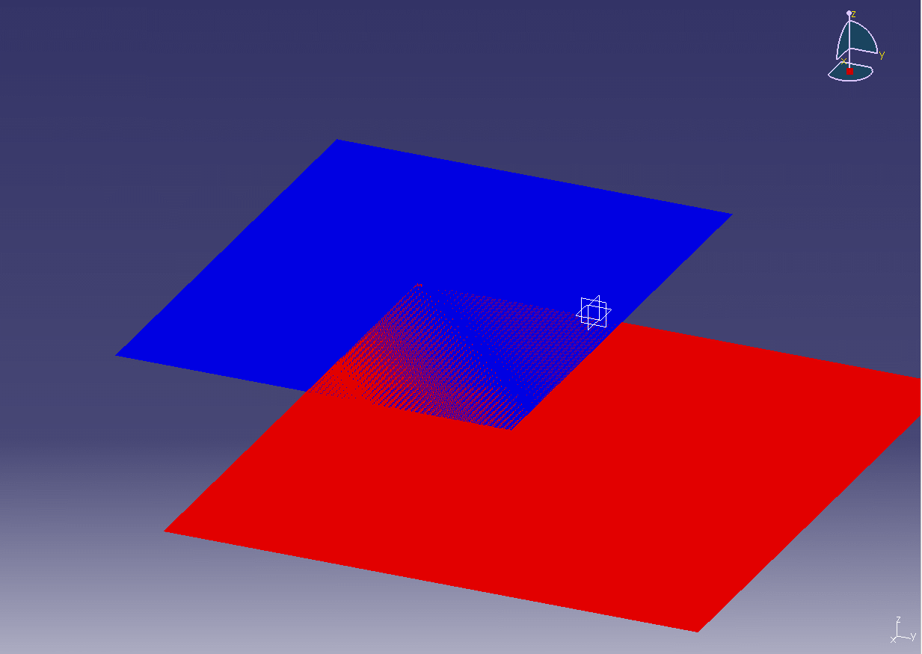
Z-Fighting
Since depth values have a limited precision, we may face situations where rounding errors cause what is called Z-Fighting.
This usually happens when triangles are nearly coplanar.
Picking a large near/far range can cause this to happen when 2 objects are near each other yet far from the camera.
Notes:
Source: https://www.neogaf.com/threads/z-fighting-stitching.975113/

Slide 103
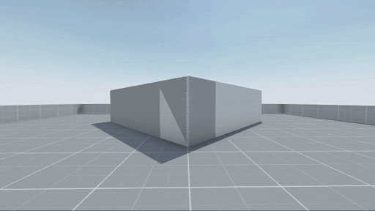
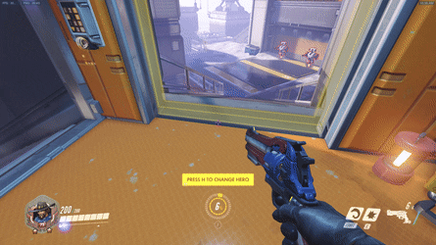
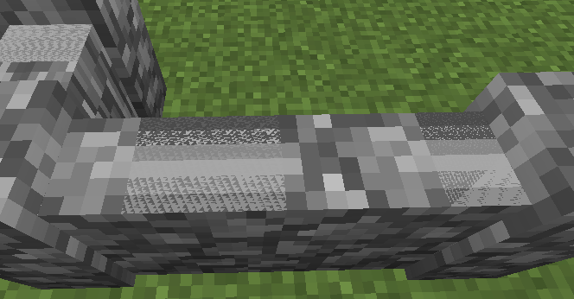
Notes:
Sources:
http://wiki.reflexfiles.com/index.php?title=File:Z_fighting.gif
https://bugs.mojang.com/browse/MC-91859?attachmentOrder=asc
Overwatch

Slide 104
How to solve Z-Fighting?
Avoid positioning parallel surfaces near each other.
Narrow the projection depth range. Make “near” as far as possible and make “far” as near as possible.
Increase the bit depth of the depth buffer.
Use depth bias (Useful for decals but hard to apply on everything).

Slide 105
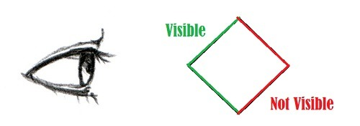
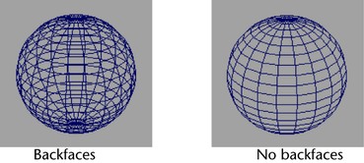
Back Face Culling
Even with early depth testing, it is inefficient to rasterize every triangle.
Some triangle will be hidden from a certain viewing direction that we don’t even want to waste time rasterizing them.
Notes:
Source: https://askagamedev.tumblr.com/post/92638684416/game-optimization-tricks-part-2-backface-culling

Slide 106
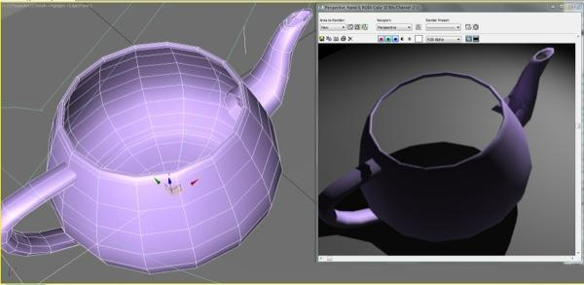
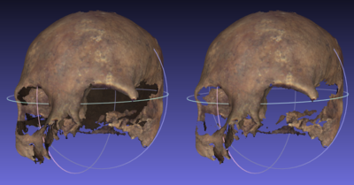
Notes:
Sources:
https://knowledge.autodesk.com/support/3ds-max/troubleshooting/caas/sfdcarticles/sfdcarticles/Backface-Cull-Object-renders-transparent-when-facing-away-from-view.html
https://en.wikipedia.org/wiki/Back-face_culling

Slide 107
glEnable(GL_CULL_FACE);
glCullFace(GL_BACK);
glFrontFace(GL_CCW);
3
3
Front Face
Back Face
CULL
Counter Clockwise
Clockwise
1
2
2
1

Slide 108
3
3
Rotate 180° around Y
Counter Clockwise
CULL
Clockwise
1
2
2
1
Front Face
Back Face

Slide 109
3
1
2
Rotate 180° around X
Clockwise
CULL
Counter Clockwise
1
2
3
Front Face
Back Face

Slide 110
3
2
1
Rotate 180° around Z
Counter Clockwise
Counter Clockwise
1
2
3
Front Face
Front Face
KEEP

Slide 111
Scene Graphs

Slide 112

This is a point in the local space of the phone
Hi
Again!
We need to get it to world space…..
What is the world space?

Slide 113

The hand is our world space.
We just need define our location relative to the hand.
But what is the hand relative to?

Slide 114

The man is our world space.
We just need define the hand location relative to him.
But what is the man relative to?
Notes:
Source: https://depositphotos.com/106971418/stock-video-man-in-bus-using-his.html

Slide 115
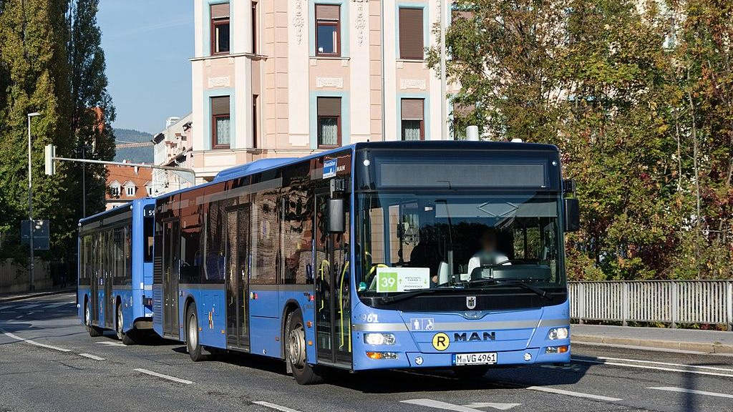
It’s the bus… oh wait?
We didn’t reach the global world space yet.

Slide 116
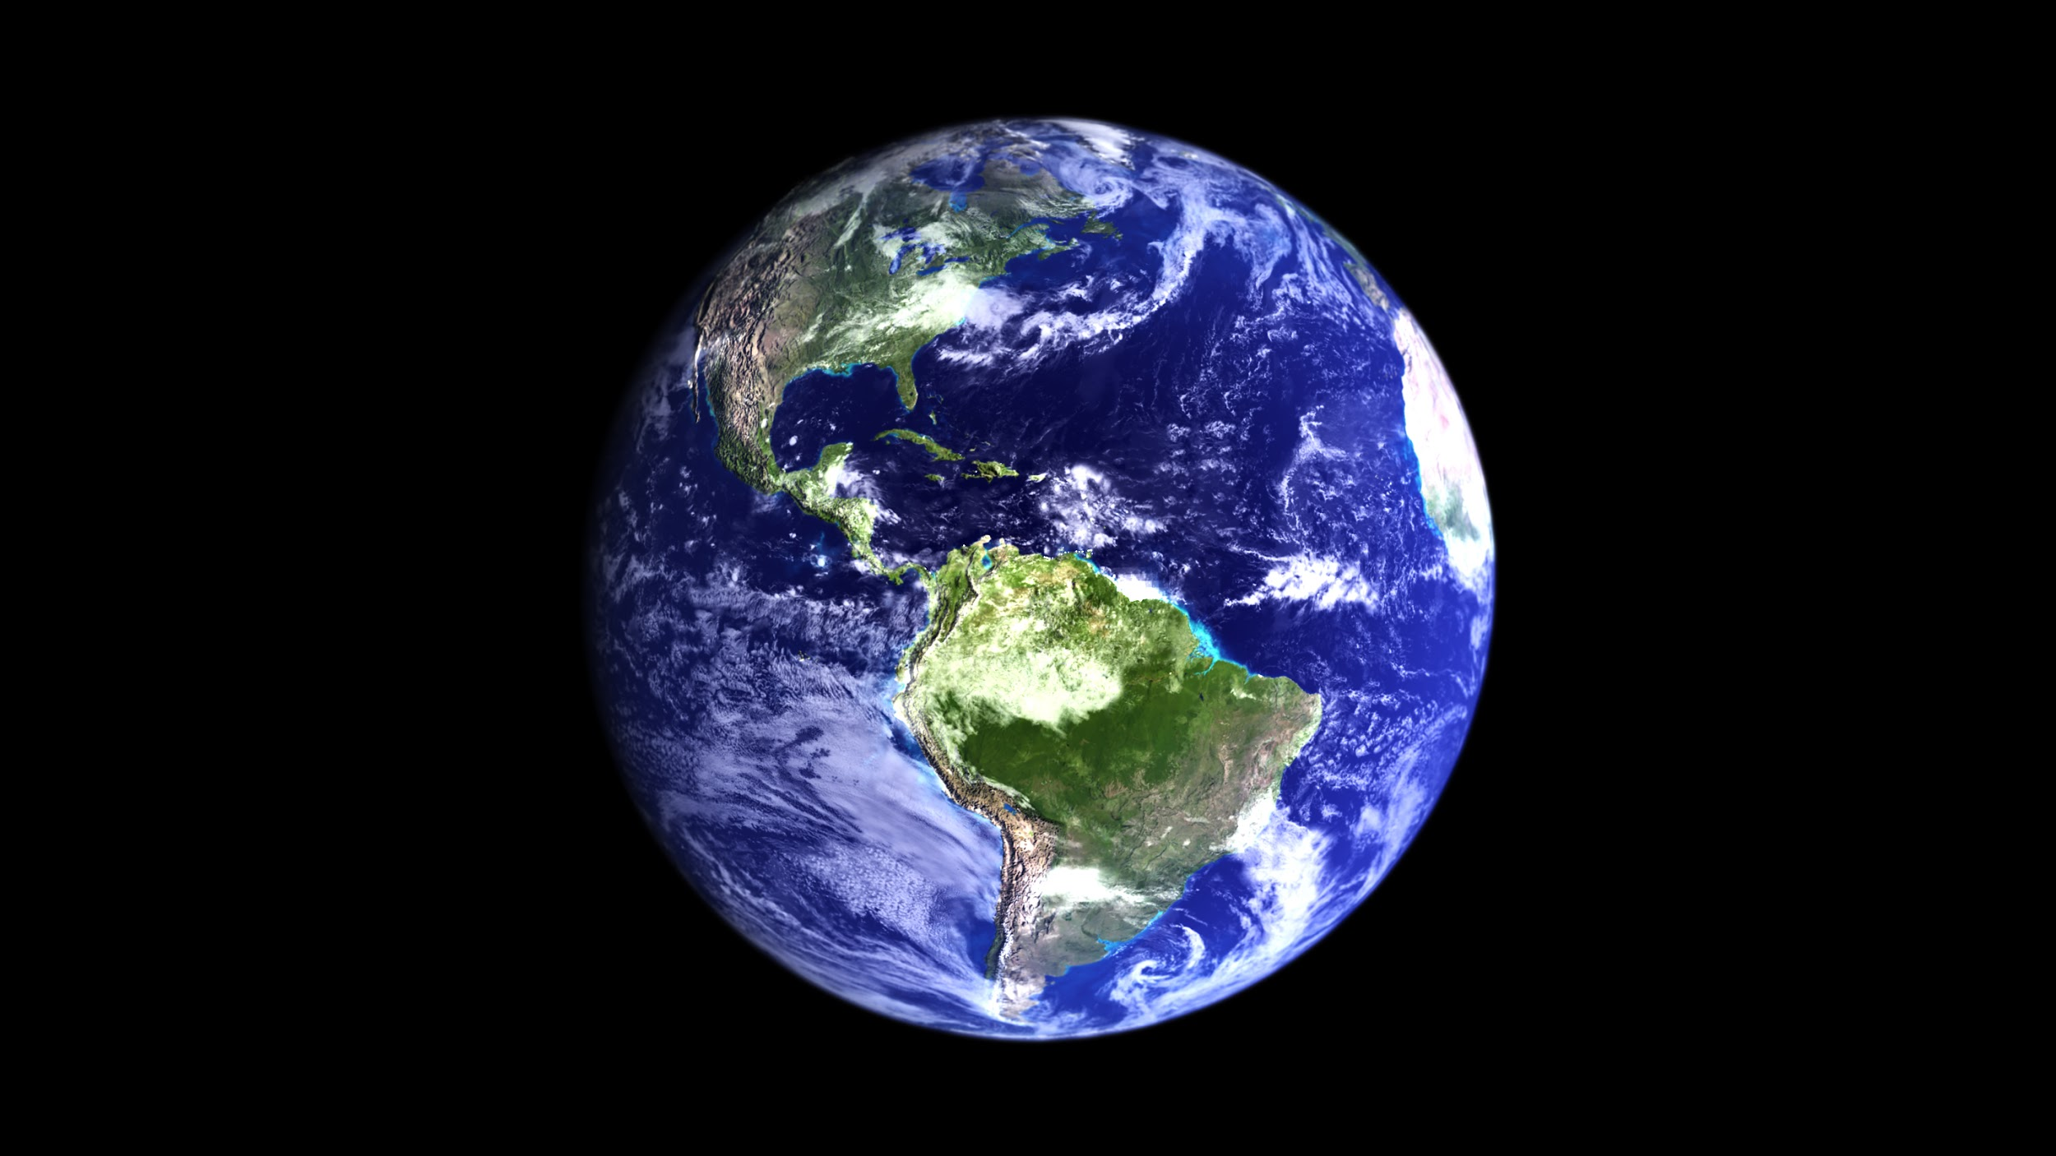
The earth is the global world sp…
Uhhh!

Slide 117
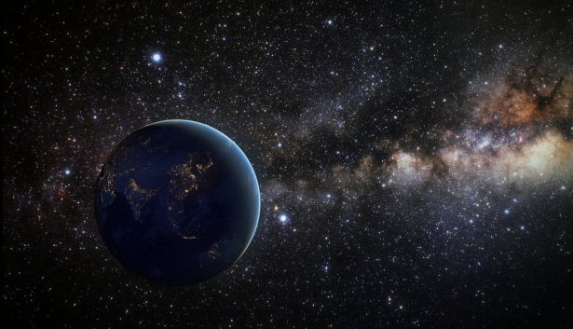
Umm.. Okay…

Slide 118
Universe
CHILD OF
Milkyway
CHILD OF
Sun
CHILD OF
Earth
CHILD OF
Bus
CHILD OF
Man
CHILD OF
Hand
CHILD OF
Phone

Slide 119
Phone_Corner_in_Root_World_Space =
Milkyway_to_Universe_Matrix *
Sun_to_Milkyway_Matrix *
Earth_to_Sun_Matrix *
Bus_to_Earth_Matrix *
Man_to_Bus_Matrix *
Hand_to_Man_Matrix *
Phone_to_Hand_Matrix *
Phone_Corner_in_Local_Space

Slide 120
Wait…
Do I need to refer everything back to the Universe?

Slide 121
Of course not.
Pick any space to be your root world space and refer everything to it.

Slide 122

Scene Graphs
It is a data structure that represents scenes as nodes.
Each node’s transformation is relative to its parent’s coordinates.

Slide 123


Slide 124

Wheel1_to_World_Space =
Car_to_Root_Matrix *
Joint1_to_Car_Matrix *
Wheel1_to_Joint1_Matrix

Slide 125
PROJECT PHASE 2

Slide 126

Entity Component System (ECS)
World
Systems
Entity #1
Entity #2
Component #1
Component #1
Component #2
Component #3
Component #3
Component #7
Component #4

Slide 127
What’s wrong with Inheritance?
Object
Character
Human
Elf

Slide 128
Object
Character
Human
Elf
Knight
Mage
Knight
Mage
???
???

Slide 129
Object
Character
Human
Elf
Human Knight
Human Mage
Elf Knight
Elf Mage
Code Duplication

Slide 130
Object
Character
Virtual void show_info();
Override show_info();
Override show_info();
Human
Elf
Knight
Mage
Human Knight
Human Mage
Elf Knight
Elf Mage
Deadly Diamond of Death
Uses whuch show_info(); in Human or Knight ??!

Slide 131
Object
Character
Profession
Human
Elf
Knight
Mage
Human Knight
Human Mage
Elf Knight
Elf Mage
Limited interaction between profession & character

Slide 132
Composition Over Inheritance
Human
Knight
Entity
Human
Knight
Human Knight
Inheritance
Composition

Slide 133
Entity
Human
Knight
Components can freely interact with each other

Slide 134
Entity Component (EC)
World
Entity #1
Entity #2
Monkey
Component #1
Data and Logic
MeshReneder
Component #3
move #3
Component #7
Component #4
Notes:
We work in EC where the entity has the data and the logic itself

Slide 135
Entity Component System (ECS)
Logic
World
Data Only
Systems
Entity #1
Entity #2
Component #1
Component #1
Component #2
Component #3
Component #3
Component #7
Component #4

Slide 136
Serialization
World
Entity #1
Entity #2
FILE
Component #1
Component #1
Serialization
Component #2
Component #3
Component #3
Component #7
Component #4

Slide 137
Deserialization
World
Entity #1
Entity #2
FILE
Component #1
Component #1
Deserialization
Component #2
Component #3
Component #3
Component #7
Component #4

Slide 138
Thank you

